Slide 1

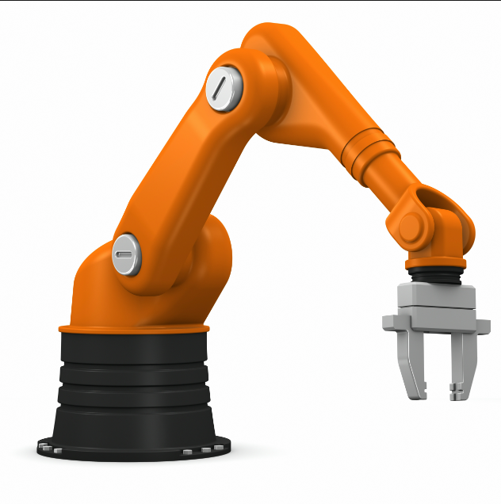
POSITION CONTROL OF ROBOTIC ARM
Linear Control Systems
Semester Project

Slide 2

Group Members
Abdur Rehman 337668
Asad Ahmed 331881
Syed Muhammad Abubakar 337385
Muhammad Taha Qaiser 332741

Slide 3

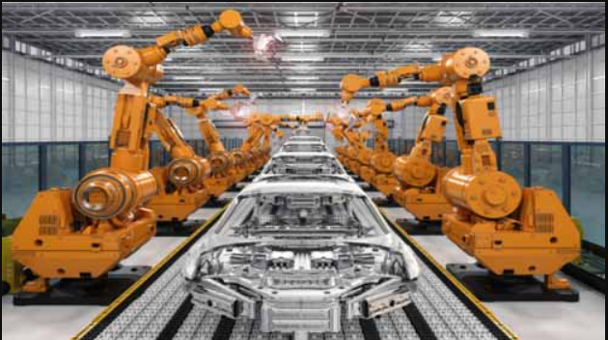
Introduction
Robotic arms, with their exceptional precision and efficiency, have revolutionized numerous industries.
To harness their full potential, a robust and adaptable control system is essential.
Simulink provides an intuitive, graphical environment for modeling, simulating, and analyzing dynamic systems.
Manufacturing Vehicles

Slide 4
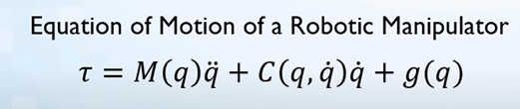
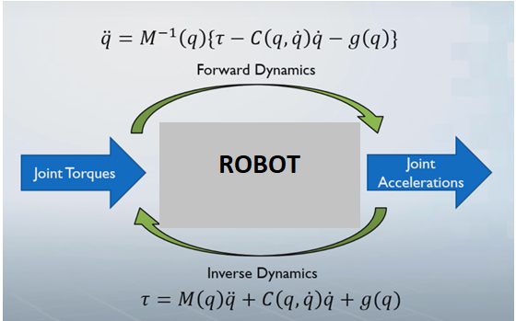
Robot Dynamics
First term represents force being consumed to produce acceleration
Second term includes forces to counter Carioles forces
Last term requires forces to overcome gravitational pull

Slide 5

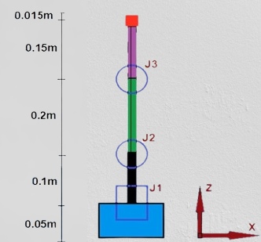
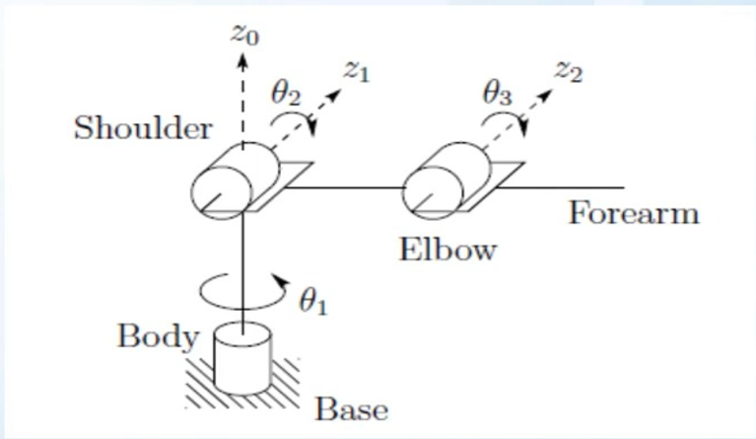
Free Body Diagram
Radius = 0.08m
Notes:
Rotation is along z-axis

Slide 6
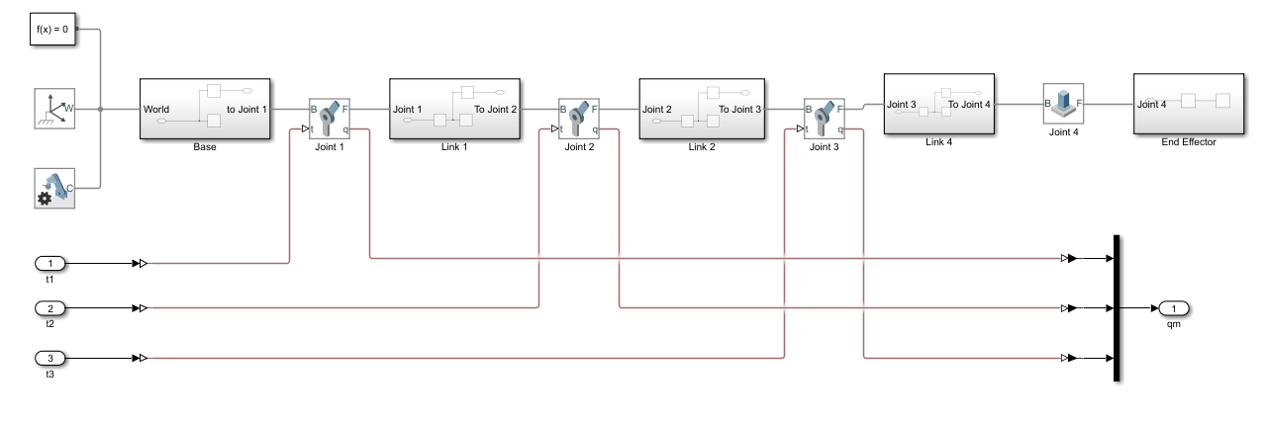
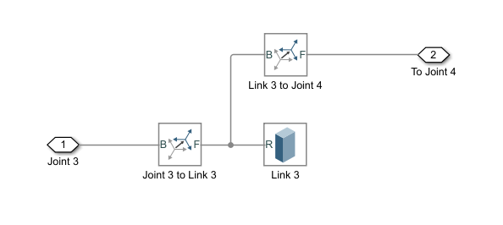
Robot structure design
Notes:
Designed using SimScape Toolbox

Slide 7
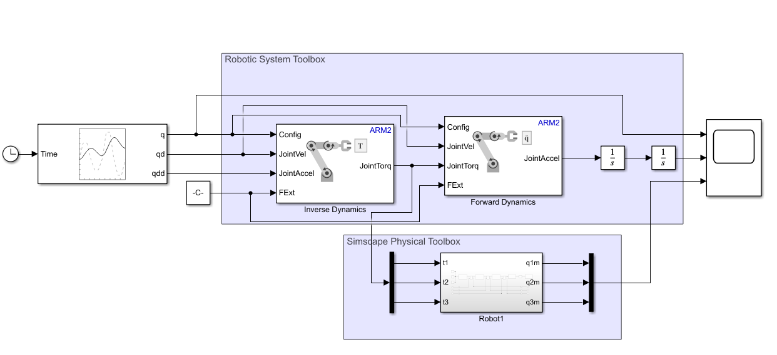
Design without controller

Slide 8
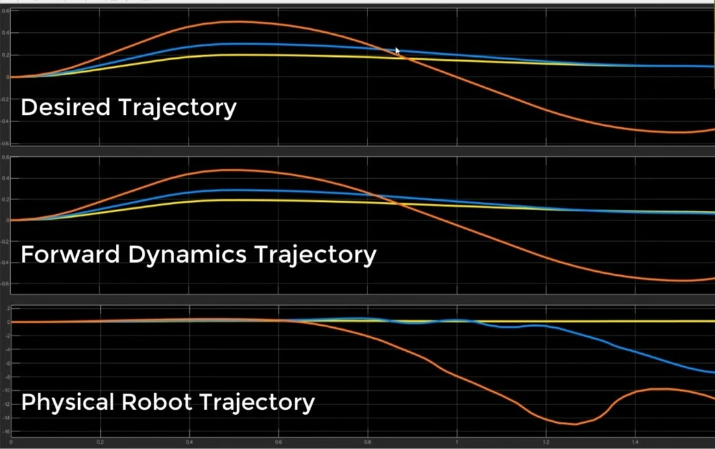

Slide 9
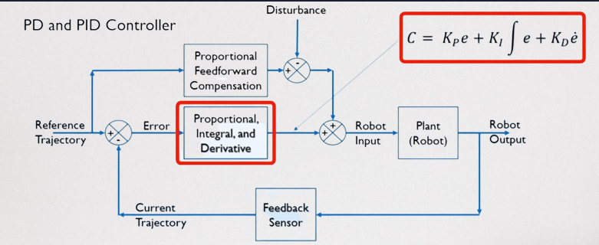
Flow Diagram with controller

Slide 10
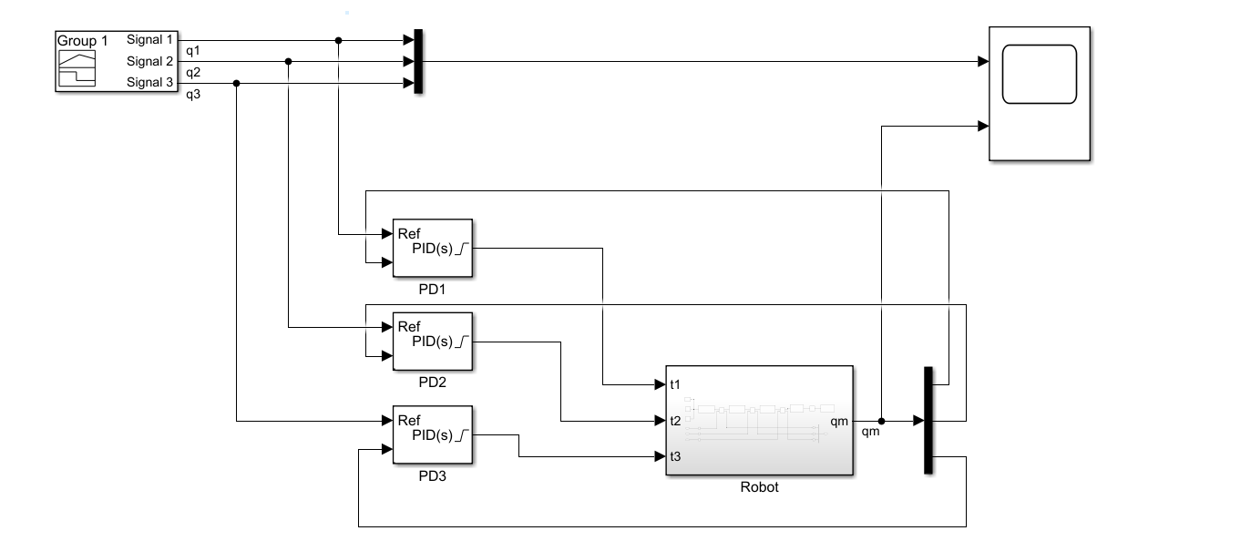
Design with controller

Slide 11
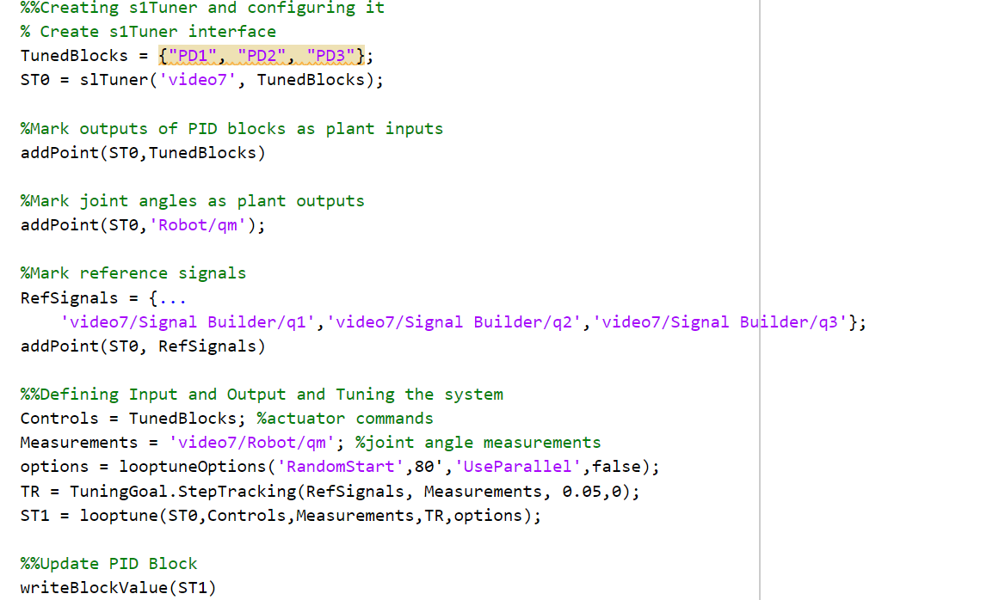
Code for tuning pID controller

Slide 12
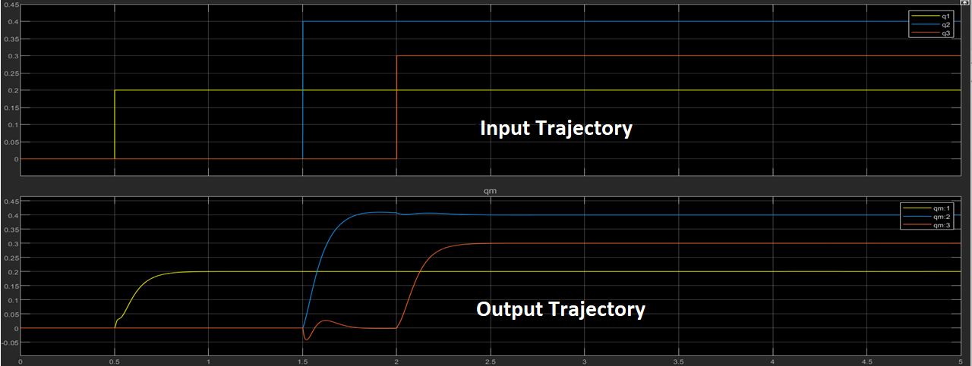

Slide 13
Outcome discussion
Comparison of graph With & W/O PID Controller
Why do the results not exactly match the input trajectory?
Why is there a ripple in the trajectory of the 3rd Joint?
Possible improvements to design

Slide 14
Current Research Areas
Adaptive control: Developing control algorithms that can adapt to changes in the environment or system dynamics, ensuring consistent performance under varying conditions.
Force control: Researching methods to precisely control the force exerted by the robotic arm, enabling delicate manipulation of objects and improved interaction with the environment.
Machine learning and artificial intelligence: Integrating AI and machine learning techniques to improve control algorithms, allowing for self-improvement and adaptation to new tasks.
Fault-tolerant control: Designing control systems capable of maintaining performance even when faced with component failures or unexpected disturbances.

Slide 15
References
Yang, J., Chen, I. M., & Yeo, S. H. (2009). A general approach for deriving the inverse kinematics of a serial robotic manipulator. Journal of Robotics, 2009. https://doi.org/10.1155/2009/284176
Siciliano, B., & Khatib, O. (Eds.). (2008). Springer handbook of robotics. Springer Science & Business Media. https://www.springer.com/gp/book/9783319325507
Han, J., Kim, D., & Kwon, D.-S. (2017). Robust precision control of a flexible robot arm using an adaptive sliding mode controller. IEEE/ASME Transactions on Mechatronics, 22(3), 1363-1373. https://doi.org/10.1109/TMECH.2017.2694118
How to design Robots using MATLAB 2021 – Youtube playlist: Learning Orbis

Slide 16

Thank You!

